Slide 1

WEB REPORTING
(DEV-EXPRESS)

Slide 2
1. First Look at the Report Designer 2. Introduction to Banded Reports 3. Bind to Data 4. Create - Types of Reports 5. Reporting Controls (Basic / Advance) 6. Report Shaping (Group & Sort , Format data, Static & Dynamic Filters , Calculated fields ) 7. Customize Report Appearances 8. Navigation (Bookmarks & Doc Map , Table of Contents) 9. print Preview & its capabilities.
Table of Contents

Slide 3
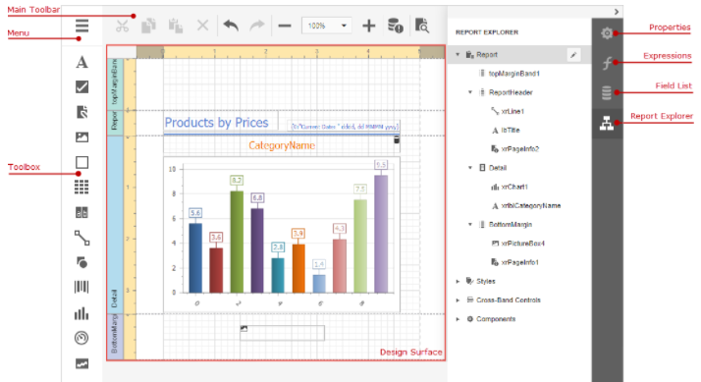
Report Designer
The Design Surface displays a report's structure and contents. You can use the tools on the Report Designer's panels to design the report
Menu – Manage the report
Toolbox to design ,
Main toolbar to editing report
Properties panel to set up report configs,
Expressions to provide data & shape report data ,
Field list to access report ds ,
Report explorer to access report elements.

Slide 4
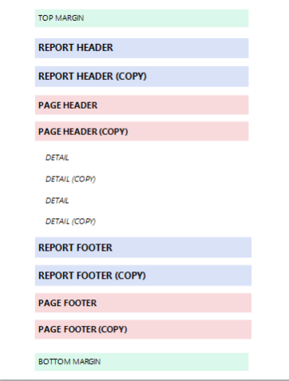
Banded Reports
Report Header and Report Footer – Data here will be displayed only once at the Start & End of Report.
Page Header and Page Footer – to display information on every page
Group Header and Group Footer - These bands are above and below each group we define.
Detail Band - displays contents as many times as there are records available in a data source until you filter it.
Margin bands - These bands are repeated at every page.

Slide 5
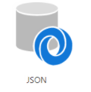
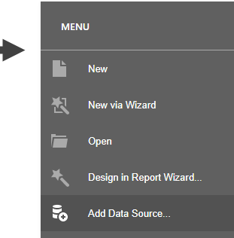
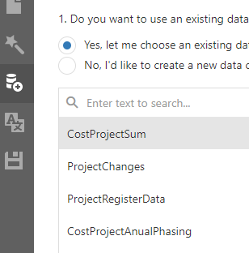
Provide Data to Reports
Bind Report to Data Base – JSON
There are various API’s exposed which can be used as Data tables for the Reports.

Slide 6
Types of Reports
Table Reports
Vertical Reports
Multi DS Report – Sub Report
Hierarchical Reports
Cross Tabs report
Label & Badges report
Interactive E forms Reports

Slide 7
Reporting Elements
Basic Elements
Advance Elements
Label
Table
Character comb
Rich Text
Check Box
Picture box
Panel
Page Break
PDF content
Lines & Shapes
Sub report
Table of Contents
Page Info
Chart
Pivot
Barcodes
Gauges
Sparklines
Cross band lines

Slide 8

Capabilities
Report Designer for Informational clarity.
Quick & Interactive Preview.
Supply Report data using various DS Types.
Rich Set of Built in Tool kit / Reporting Elements.
Easy to configure & Time reducing in development
Components easily available on Reporting Surface just Drag & Drop.
Data Export is available in various forms.
Filter data , Can create binding expressions based on requirement of any complexity.

Slide 9
Limitations
Dev Express Web Reporting Unable to handle large data Set (Too many data columns / Set of Records )
Reason : When you edit a report in the Report Designer, your working space is limited by the XtraReport.PaperKind that you select. A report is not a data grid, it cannot have an infinitely wide area with a horizontal scrollbar. Therefore, the only way to fit more columns into a given page is to either make the font smaller or the page bigger.

Slide 10
Nestle ~ Project Pivot Report Phase Data
Data Table
Main Pivot
Project Analysis
CAPEX 2021 Chart
SBU 2021 Chart
Workflow Stats

Slide 11
Thank You.

